Slide 1
ROBO-ADVISOR INTERFACE
8 March 2018 Draft

Slide 2
Overview
The goals of robo-advisor:
Win trust from users
Orient users to investor more money with it
Sutbly orient users toward committing patient long-term investment
The goals of users:
Make more money with robo-advisor
Infer robo-advisor’s expertise in portfolio management
Make rational decisions given available information

Slide 3
Overview
Stage 1 | 1. User orientation
Stage 2 | 2.1: Showcase demo
 | 2.2: Manipulation check
Stage 3 | 3.1: Main experiment
 | 3.2: Final evaluation
Build a first impression
Start building trusting relationship through trial investment
Measure how much trust is built during the previous two stages
Evaluate the overall user experience
Through robo-advisor’s avatar, greetings, and orientation instruction
Through service instruction, trial performance, and effective presentation of related information
Through providing prompt feedback to market atmosphere and users’ decisions and different conversational styles
Based on all previous interaction

Slide 4
 | Chief tasks | Deliverables & DDL
Week 1 Mar 5-11 | First draft of mock-up (Wanlu) Initiate IRB preparation (Yihan) Design script styles (Yihan) | Mock up: Mar 8; IRB basic info: Mar 9; Key points on script styles: Mar 8;
Week 2 Mar 12-18 | Develop the basic functional components (Wanlu) Draft scripts for orientation & main experiments (Cuimin) Fill in IRB form (Yihan) Look for graphic designer (Yihan) | A functional surface product: Mar 15; First draft of scripts: Mar 16; First draft of IRB: Mar 15; 1-2 candidates of designer: Mar 15;
Week 3 Mar 19-25 | Integrate the front-end and back-end components (Wanlu) Design script logic flow + IRB revision (Yihan) Revise scripts (Cuimin) Start UI design (TBA) | A semi-functional product: Mar 22; Revised scripts; Revised IRB application; Mock-up of UI design;
Week 4 Mar 26 – Apr 1 | Integrate scripts into the product and make it ready for user test (Wanlu) Submit IRB Revise the front-end according to UI design (TBA) | A fully functional product: Mar 29; IRB submission
Week 5 Apr 2 -8 | User test (Yihan + Cuimin) Debugging & iteration according to user test | Invite at least 5 users and summarize the results: Apr 6;

Slide 5
Orientation - attributes
Attributes of robo-advisor:
Name (Elite vs. grass-root: Warren vs. Tom)
Gender (male, female, neutral)
Profile picture (with different dress code: consultant vs. butler)
Conversational style (controlling vs. submissive)
Performance(high, medium, low)

Slide 6
Orientation -
Design of robo-advisor avatars
 | Professional consultant | Peer consultant
Name | Name associated with Elite/dominance | Name associated with Peer/submissive
Avatar profile | Professional dress code + More expressive facial expression | Approachable dress code More reserved facial expression
Conversation manner | Initiates | Responds after user enquires
Conversational style | use unassertive language | Use questions & suggestions

Slide 7
Orientation - greetings
Greetings:
Robo: Hi, my name is Tom and I help people manage their portfolio. How are you doing today?
User: I’m feeling good [for wanlu: two options]
Robo: May I get to know a little more about you? (see example in the next page)
User: My name is ___(for wanlu, fill in the blanks), I’m ___ (for wanlu: gender options here). I’m ___ (marital status), and have ___children (number of children). My annual income is about ___(income range options), and my expectation for you is ___ (options of annualized return: 5%, 10%, 15%).
Robo: Thank you very much! Now I’ll work out a wealth management plan for you
User: I’m ready to proceed

Slide 9
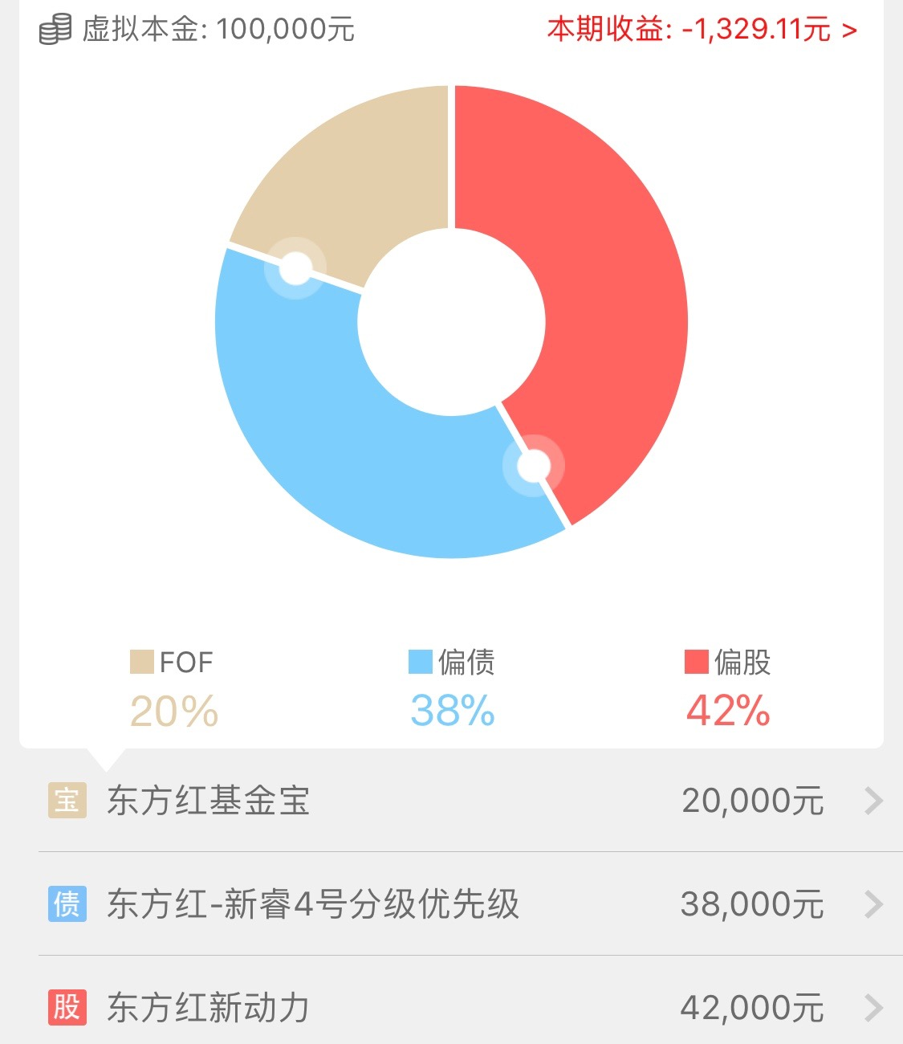
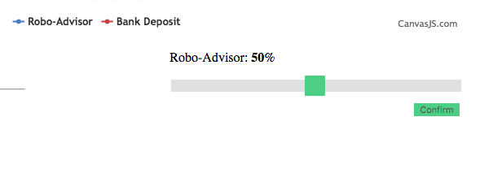
Slider to Pie
Current version:
Optimized version:

